Slide 1
Virtual Private
Network
(VPN)
Oleh :
Alvintha M.H 2110171034
Anisa Kamila 2110171053

Slide 2
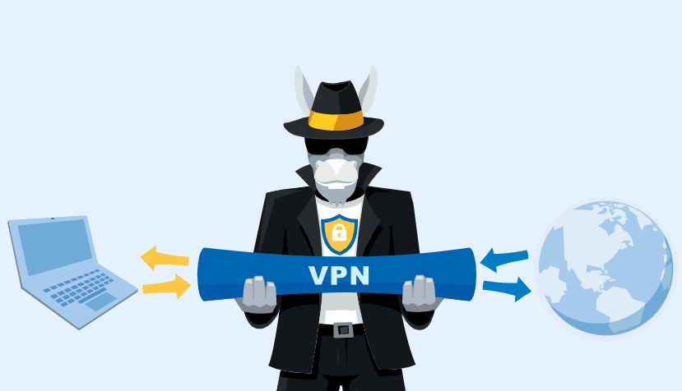
Apa itu VPN?
Virtual Network
- Jaringan hanya bersifat virtual.
- Tidak ada koneksi jaringan secara riil antara 2 titik yang akan berhubungan.
Private
- Jaringan bersifat private
- Data yang dikirimkan terenkripsi
sehingga tetap rahasia meskipun
melalui jaringan publik.
VPN (Virtual Private Network)
sebuah koneksi private melalui jaringan publik yang bersifat virtual.

Slide 3
Enter Your Tittle
Standard 4:3
This PowerPoint Template has clean and neutral design that can be adapted to any content and meets various market segments. With this many slides you are able to make a complete PowerPoint Presentation that best suit your needs.
This PowerPoint Template has clean and neutral design that can be adapted to any content and meets various market segments. With this many slides you are able to make a complete PowerPoint Presentation that best suit your needs.

